Slide 1

Title: Multiple choice questions quiz generator
Student Name: Saranya Aluru
Student ID: 2520080012
Cluster:1
Section: 2
Under the Guidance
of
Supervisor Name: Sindhuja
Assistant Professor
Department of CSE

Slide 2
OUTLINE
Abstract
Existing System
Proposed System
System Architecture
Project Modules
Objectives
Co’s Attainments - FWD
  Co1
  Co2
  Co3
  Co4
  Co5
Screen Shots for FWD prject
Conclusion
Geo-Tagged Photos

Slide 3
Abstract
This project is an interactive web-based quiz application developed using HTML, CSS, and JavaScript . It is designed to test general knowledge through 10 specific questions while incorporating a dynamic difficulty management system.
Key Features & Logic The application features a unique "Miss-Limit" system based on user-selected difficulty:
Hard: 3 misses allowed
Medium: 5 misses allowed
Easy: 7 misses allowed
Each correct answer awards 1 point. To successfully complete the quiz, the user must satisfy two conditions: they must not exceed the miss limit of their chosen difficulty, and they must achieve a minimum score of 5 out of 10.

Slide 4
Existing System
In the current environment, basic knowledge assessments or classroom quizzes are often conducted using traditional methods, such as:
Paper-Based Testing: Questions are printed, and grading is done manually by an instructor.
Static Digital Forms: Simple online forms (like Google Forms) that collect answers but do not provide immediate interactive feedback or "live" consequences based on performance.

Slide 5
Limitations of Existing System
No Dynamic Difficulty: Existing systems usually have a "one-size-fits-all" approach. They don't allow a user to test their skills under different "miss-limit" constraints (Hard/Medium/Easy).
Static Logic: Traditional forms cannot automatically end a session the moment a user exceeds a certain number of mistakes; they require the user to finish the entire test before showing results.
Poor User Experience: Manual or basic systems lack an engaging interface, animations, and responsive design that works on both mobile and desktop.

Slide 6
Proposed System
The proposed system is a Dynamic Web-Based Quiz Application that automates the assessment process through real-time logic. It replaces manual grading with an interactive interface that evaluates user performance instantly.
Key Features:
Tiered Difficulty: Allows users to choose their challenge level (Easy, Medium, or Hard), which dynamically sets
a "Miss Limit" (7, 5, or 3 misses).
Instant Evaluation: Uses JavaScript to track scores and enforce a strict Pass/Fail rule (score>=5 to pass).
After attempting the quiz you can see the answers you have got write and for the answers you have got wrong you can see the right answer.
Automatic Termination: The quiz ends immediately if the user exceeds the allowed number of misses for their selected difficulty.
Modern Design: Built with CSS Grid and Flexbox for a responsive, mobile-friendly layout.

Slide 7
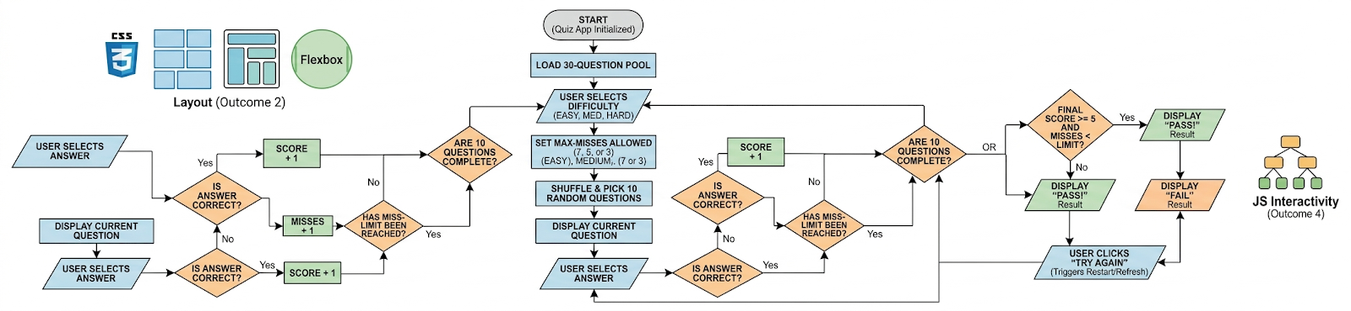
System Architecture

Slide 8
Project Modules
1. Interface Module (The Look)
This is the front-end of the app that the user sees and interacts with.
Difficulty Buttons: Allows the user to pick Easy, Medium, or Hard.
Responsive Layout: Uses CSS Grid and Flexbox so the quiz looks good on both phones and computers.
Screen Switcher: Automatically hides the "Home" screen and shows the "Quiz" screen when the user is ready.
2. Question Module (The Data)
This part handles the 30 questions you added.
Question Bank: Stores all 30 questions and their correct answers.
Randomizer: Every time you play, it picks 10 random questions so the quiz isn't the same twice.
Content Loader: Puts the text and options onto the screen one by one.

Slide 9
Project Modules
3. Logic Module (The Brain)
This is the JavaScript code that runs while the user is answering.
Answer Checker: Detects if the user clicked the right or wrong button.
Live Tracker: Keeps a real-time count of the Score and the Misses.
Auto-Stop: If a user makes too many mistakes (based on their difficulty), it stops the quiz immediately.
4. Results Module (The Grading)
This handles the final "Report Card" at the end.
Pass/Fail Checker: Applies the rule: If Score is 5 or more, you Pass.
Summary Display: Shows the final score (e.g., 8/10) and total misses.
Reset Button: Lets the user restart the quiz to try again with new questions.
.

Slide 10
Objectives
To Implement Algorithmic Logic: Create a system that automatically grades answers and applies specific rules, such as the score>=5 requirement to pass.
To Enable Dynamic Difficulty Levels: Develop a feature that allows users to choose between Easy, Medium, and Hard modes, which dynamically changes the "Miss Limit" constraint.
To Ensure Content Variety: Use a shuffling algorithm to randomly select 10 questions from a pool of 30, ensuring that the assessment remains challenging and non-repetitive.
To Provide Real-Time Feedback: Build a live tracking system using JavaScript so users can see their score and mistakes instantly as they progress.
To Demonstrate Responsive Web Design: Use CSS Grid and Flexbox to ensure the application works perfectly on all devices, including mobile phones, tablets, and desktops.

Slide 11
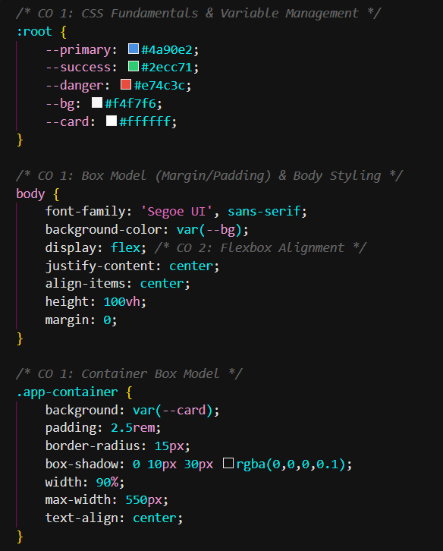
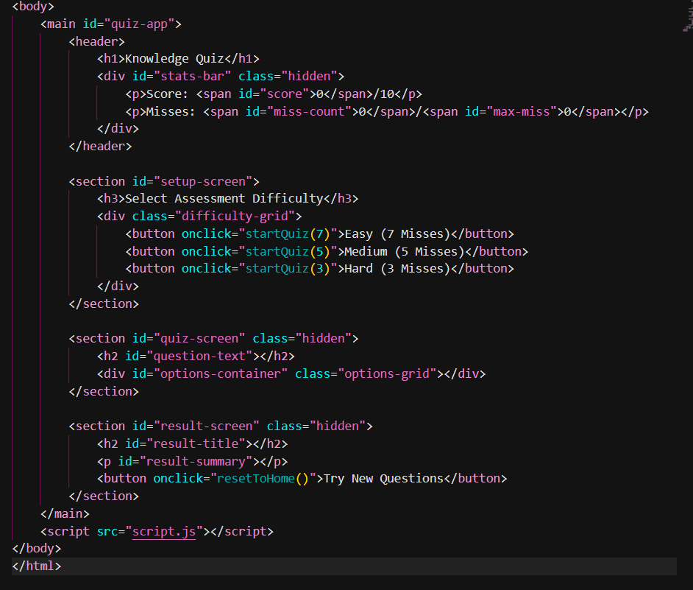
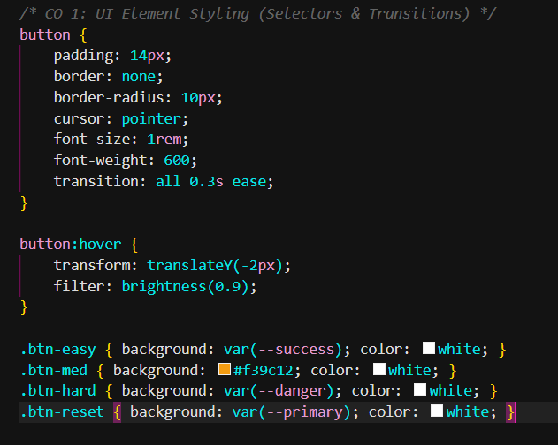
Co’s Attainments - FWD
CO 1:
The application utilizes an external stylesheet to manage the visual presentation.
Basic html body
CSS Variables are used for consistent theme management, and the Box Model (margins, padding, borders) ensures a clean, professional user interface.

Slide 12
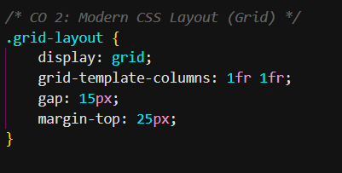
Cont’d
Co2:-
The structure follows modern web standards for document flow and responsiveness.
Uses Semantic HTML5 tags like header etc.CSS Grid to organize answer options into a 2x2 matrix and Flexbox for precise alignment.

Slide 13
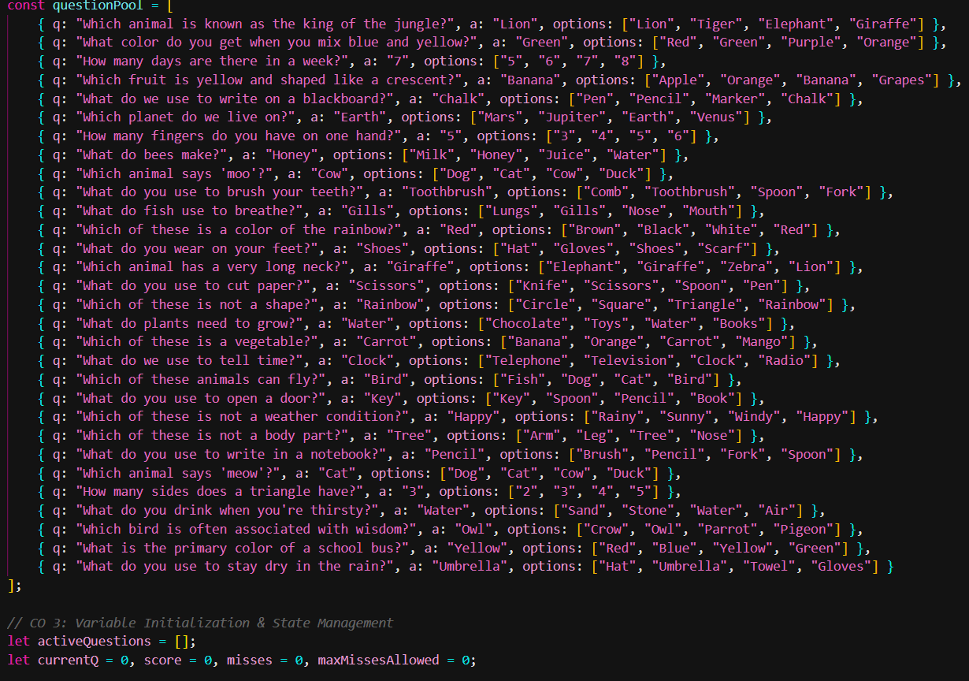
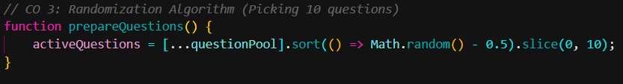
Cont’d
Co3:-
Advanced scripting is used to manage data and randomization.
The 3-question bank is stored in a JavaScript Array. An algorithmic shuffle picks 10 random questions
per session, ensuring the content is unique for every attempt.

Slide 14
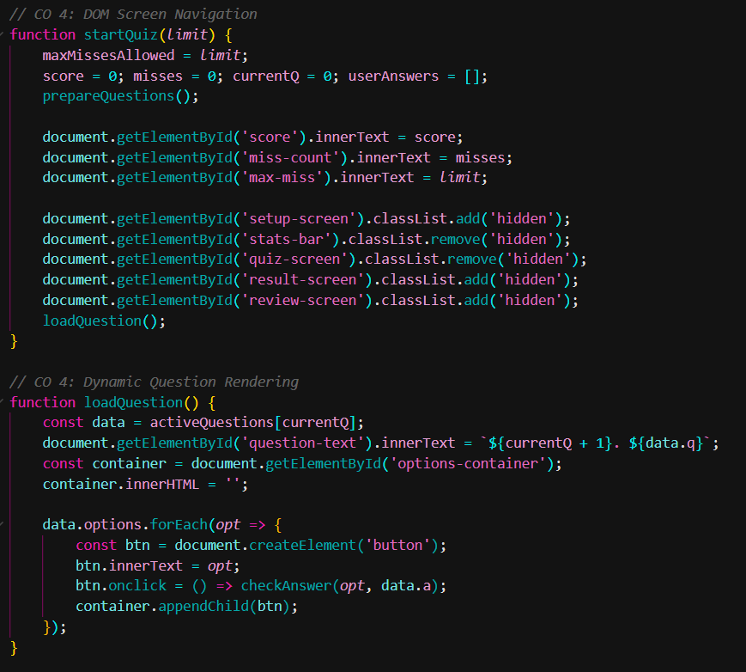
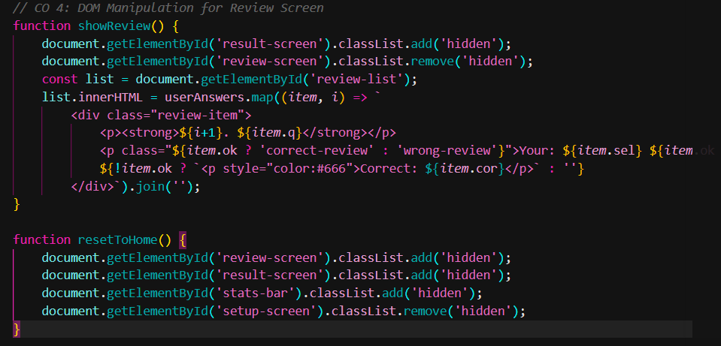
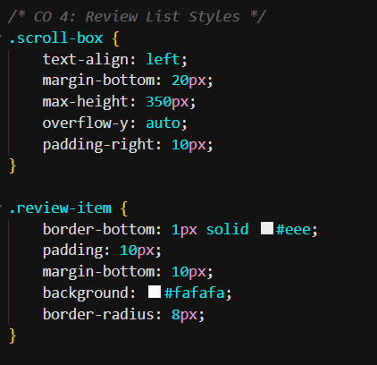
Cont’d
Co4:-
The application responds instantly to user input through the
Document Object Model (DOM). The DOM is updated dynamically
to refresh the score and question text on the screen without a full page reload.

Slide 15
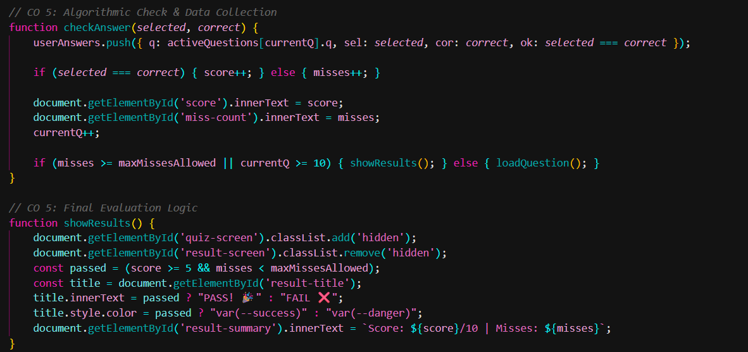
Cont’d
Co5:-
Complex conditional logic governs the assessment outcome and difficulty.
1. Passing Condition: A strict evaluation logic requires a minimum Score of 5/10.
2. Difficulty Constraint: A tiered "Miss Limit" (3, 5, or 7) is enforced based on the initial user selection
to terminate the session if accuracy drops too low.

Slide 16
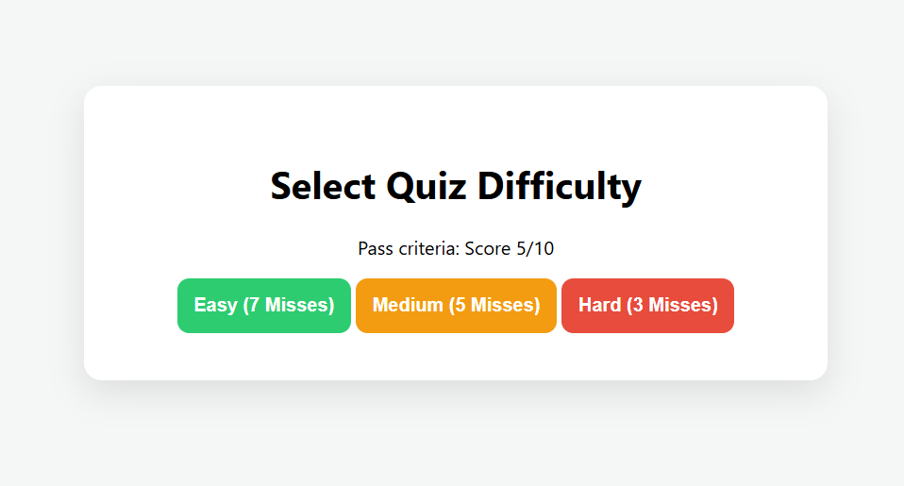
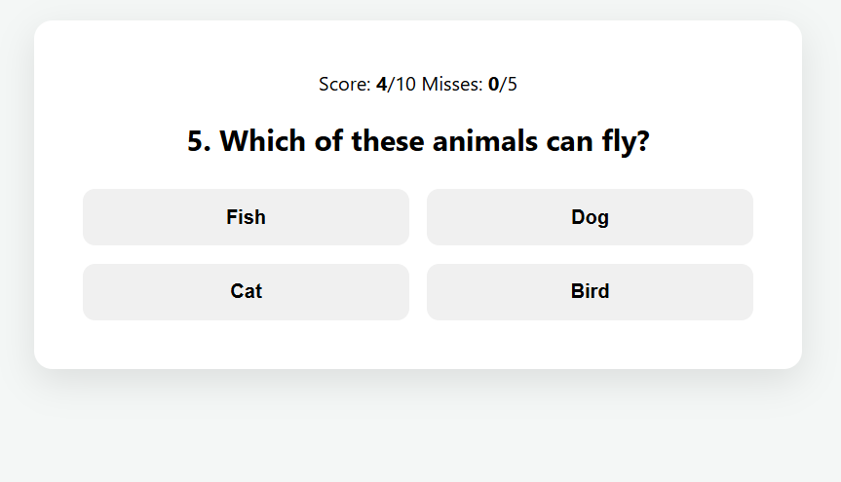
Screenshots for FWD

Slide 17
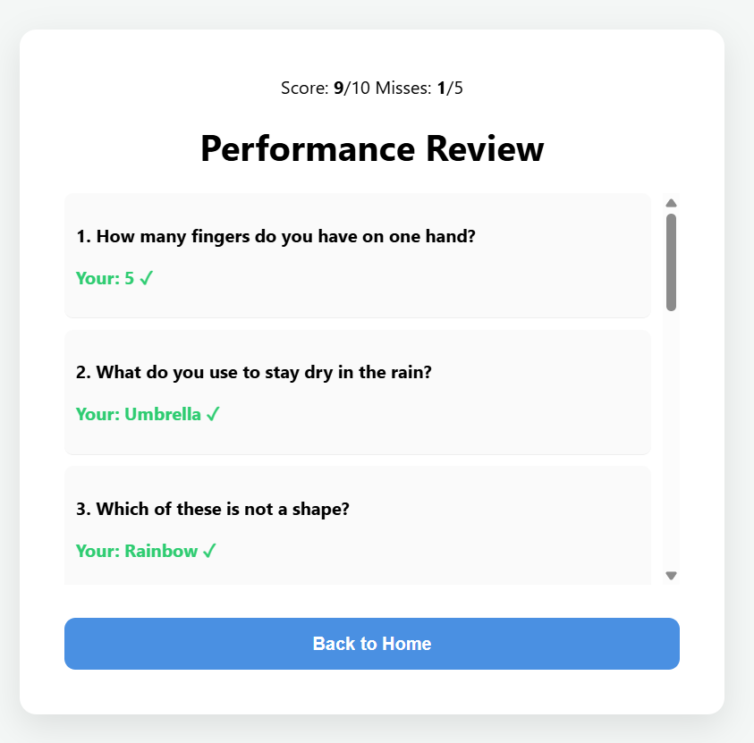
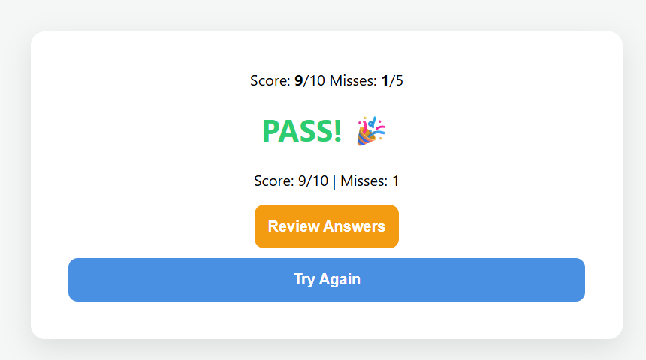
Screenshots for FWD

Slide 18
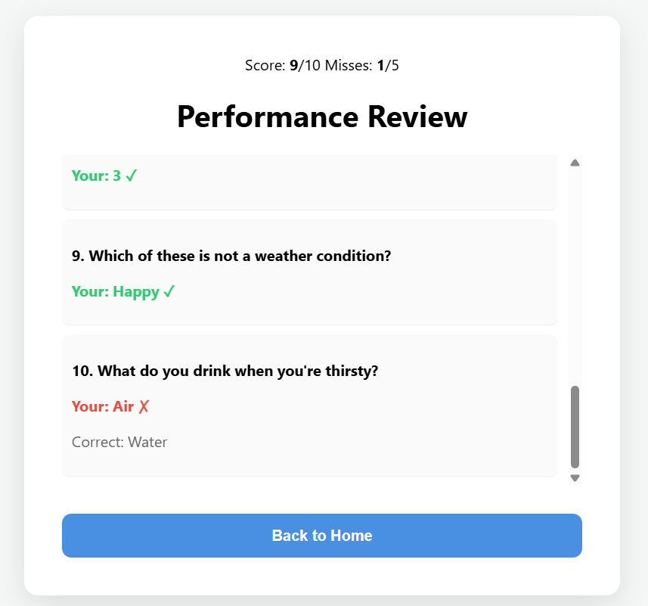
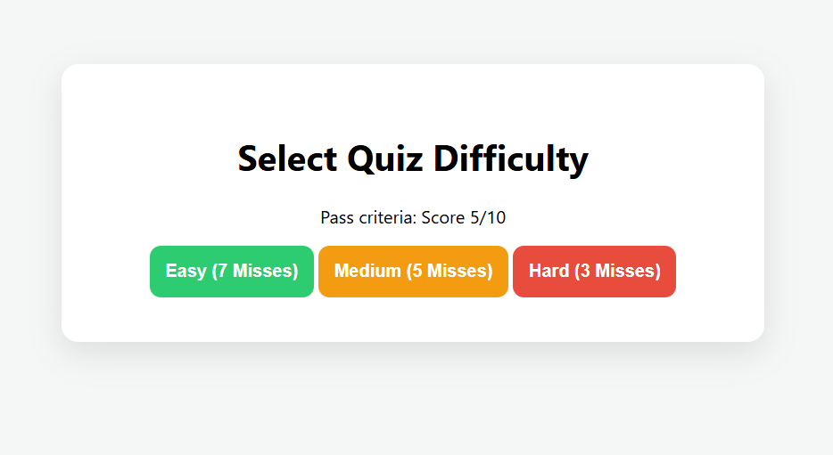
Screenshots for FWD

Slide 19
Conclusion
The Interactive Quiz Assessment System successfully demonstrates a complete web application built using HTML5, CSS3, and JavaScript. By integrating a randomized 30-question pool and tiered difficulty levels, the project achieves a balance between user engagement and automated evaluation.
The project effectively meets all Course Outcomes (CO 1–5), moving from basic styling and semantic structure to advanced algorithmic logic and real-time DOM manipulation. It proves that a Single Page Application (SPA) can efficiently handle complex state management and provide instant, accurate feedback to users

Slide 20
Geo- Tag Photos

Slide 21
THANK YOU

